Slide 1
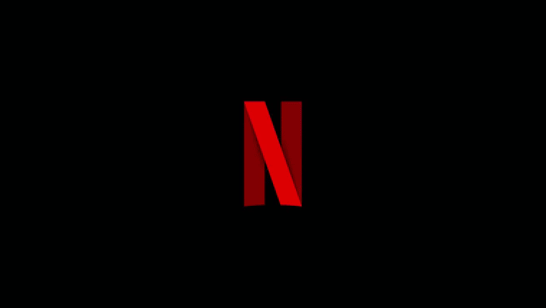

Slide 2
Netflix

Slide 3


Netflix
Who’s Reporting?
Manveen Kaur
Vidhi Goyal
MANAGE REPORTERS

Slide 4



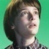
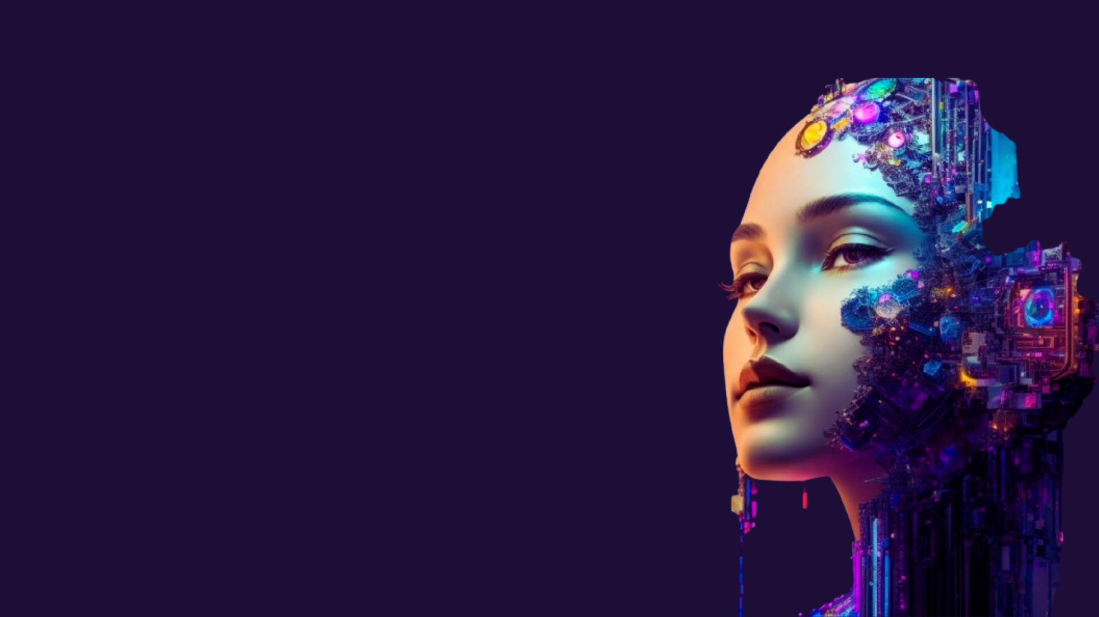

Netflix
Home
TV Shows
Movies
New & Popular
My List
KIDS
MOVIE RECOMMENDATION MODEL
PURPOSE
PURPOSE:
To build a movie recommendation system using machine learning techniques, allowing users to discover movies similar to their preferences.
OBJECTIVE:
OBJECTIVE
1.Create a user-friendly frontend using Streamlit to display recommendations.
2.Preprocess and analyze movie metadata to extract relevant features.
3.Use content-based filtering to recommend movies based on cosine similarity.
4.Integrate a movie poster API for a visually appealing user experience.

Slide 5
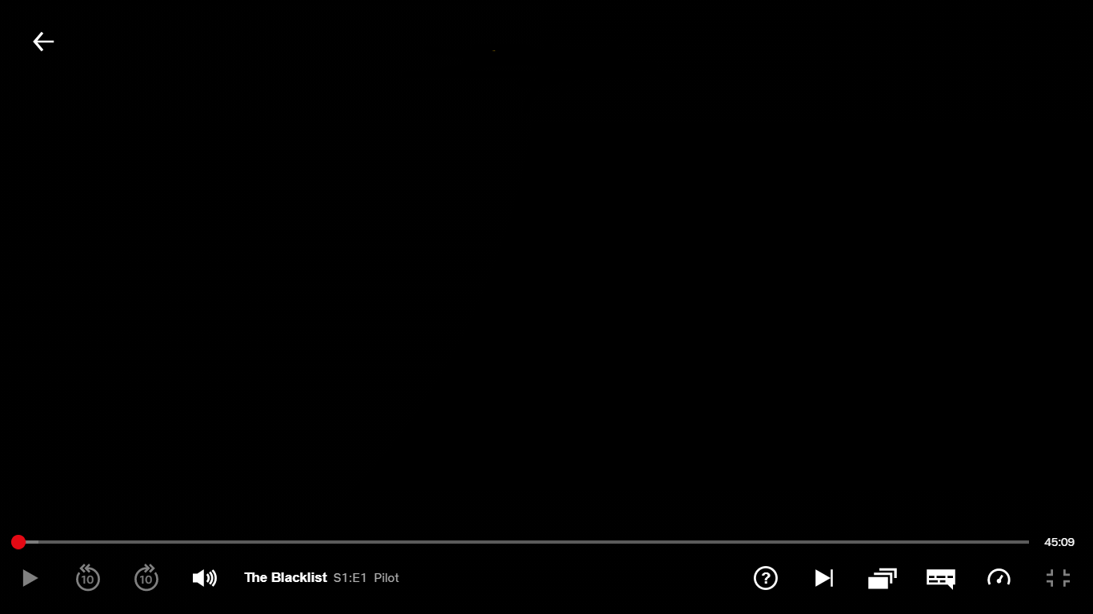
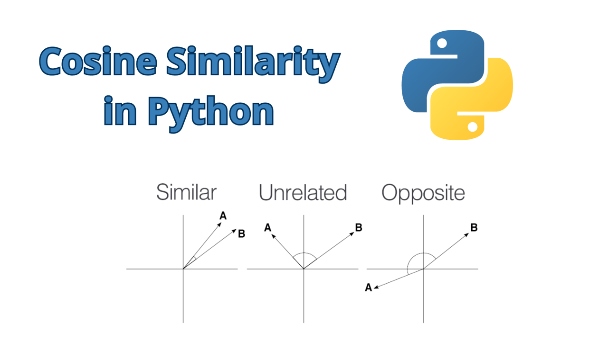
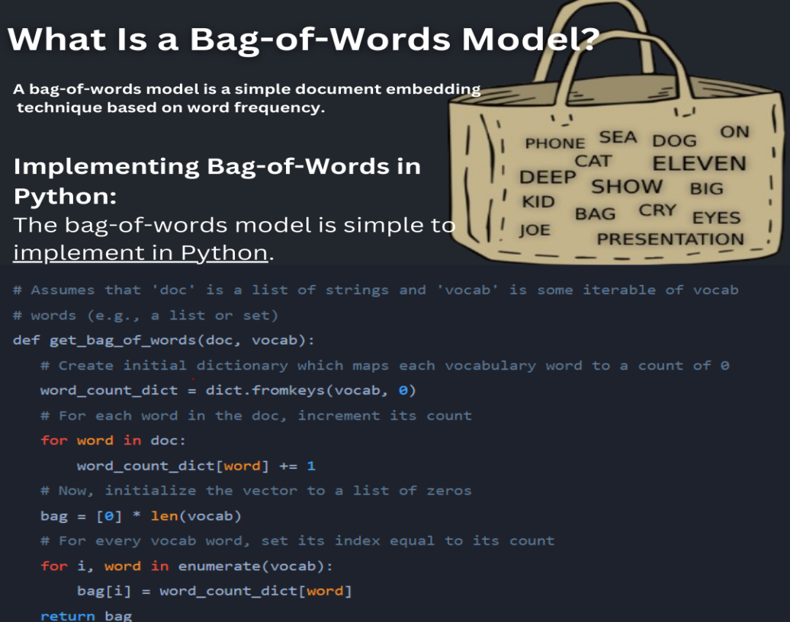
LITERATURE REVIEW
1.Recommendation Systems:Content-Based Filtering:
Relies on analyzing the features of items (e.g., genres, cast, crew) to recommend similar ones.
Example: If a user likes a sci-fi movie, the system suggests other sci-fi movies.
2.Text Vectorization:
Bag of Words (BoW): Converts text into numerical vectors based on word frequency.
Cosine Similarity: Measures the closeness of vector representations to find similar items.
3.Integration with APIs:
TMDB API is used to fetch movie posters, enhancing the user interface.
4.Applications:
Widely used by platforms like Netflix, Amazon, and YouTube to boost user engagement and retention.
LITERATURE REVIEW Part 1

Slide 6
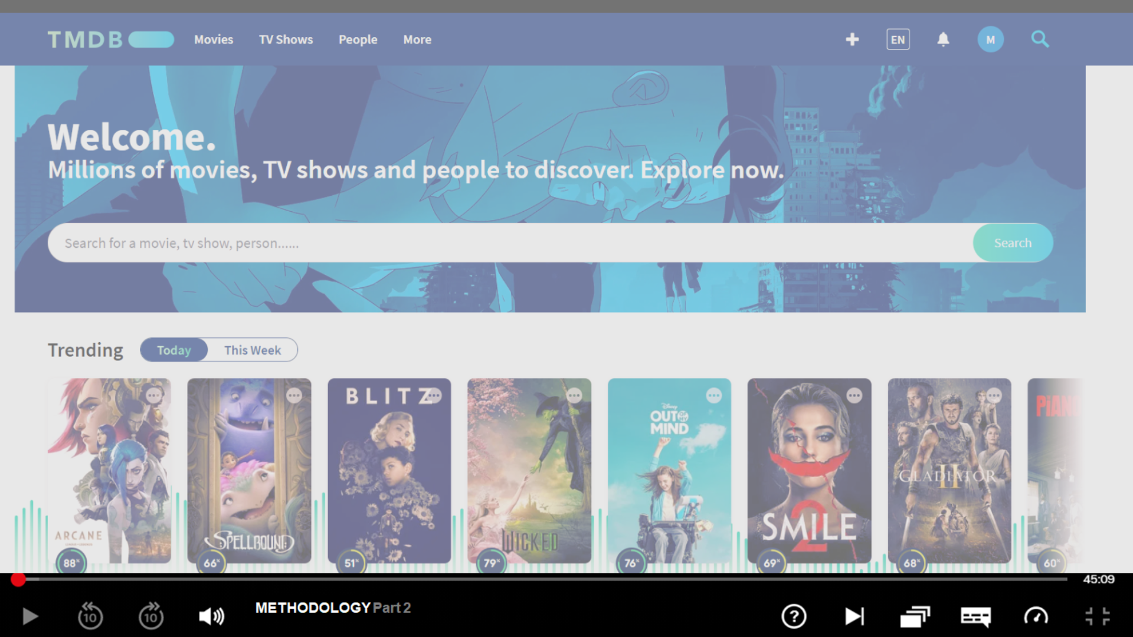
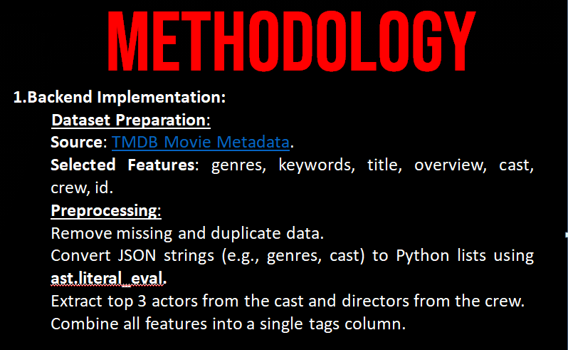
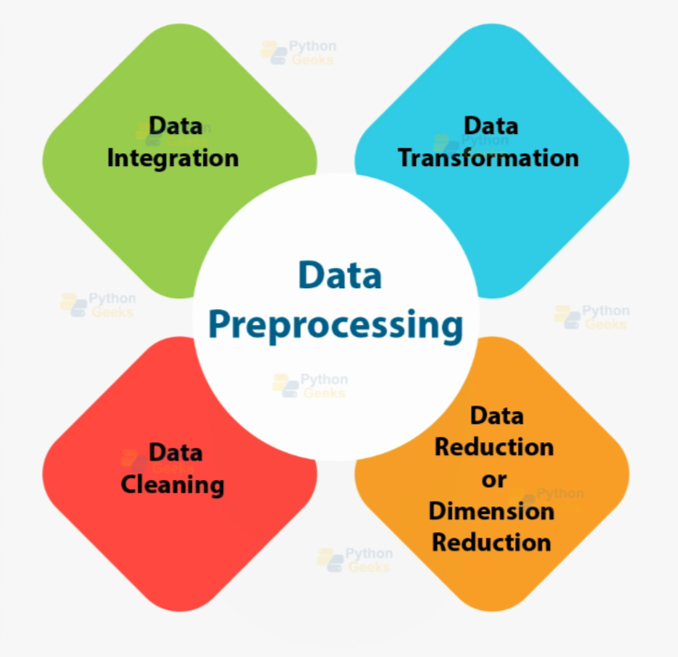

Slide 7
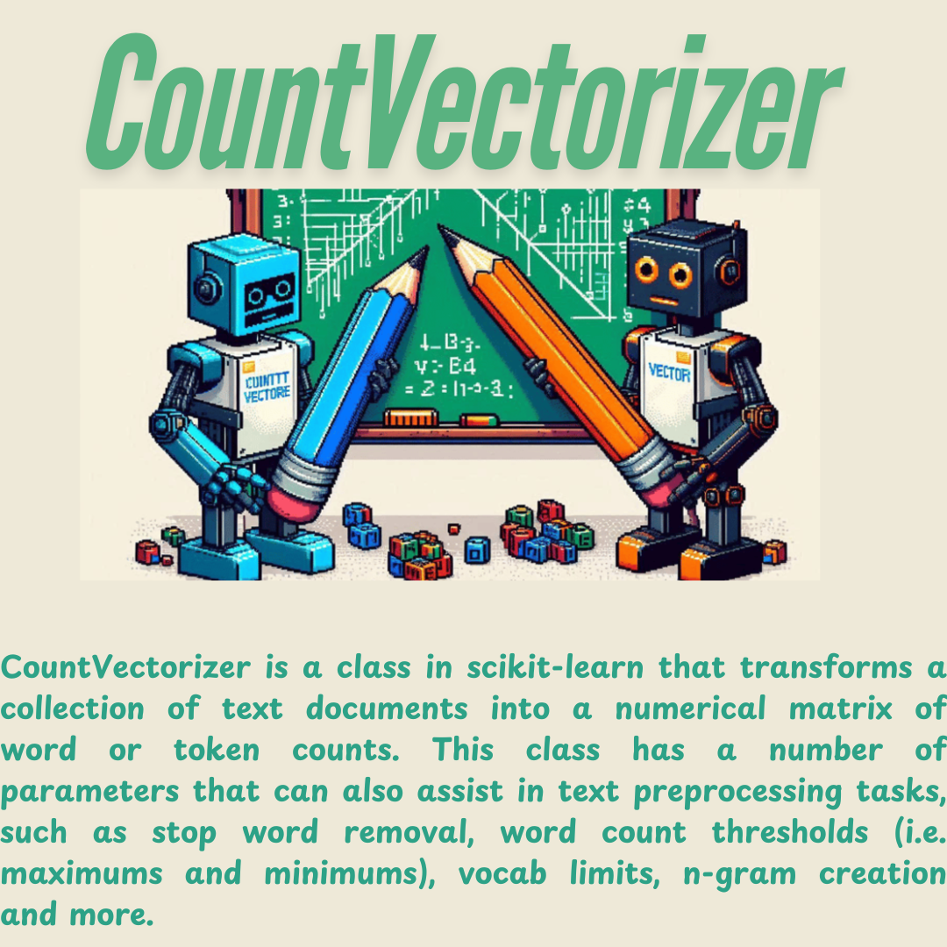
METHODOLGY
Text Vectorization:
Used CountVectorizer with a max feature limit of 5000 and removed stop words.
Represented each movie's tags as vectors for similarity calculations.
Similarity Calculation:
Used cosine similarity to compute distances between movie vectors.
Stored similarity matrix for efficient lookup during recommendations.
Recommendation Logic:
Retrieved the top 5 most similar movies for a given input title using sorted similarity scores.
METHODOLOGY Part 2

Slide 8
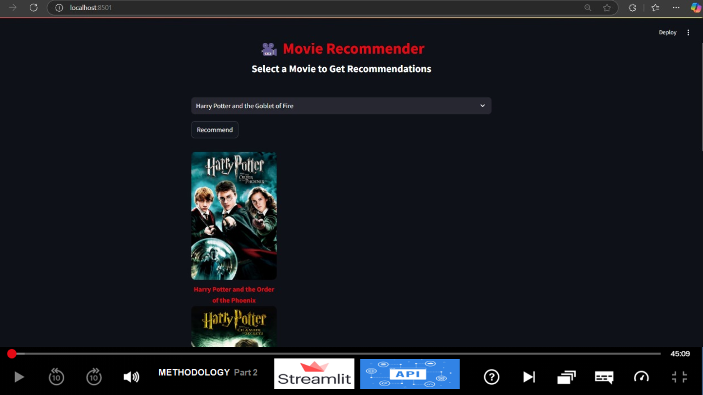
Frontend Implementation:
Framework:
Built the user interface using Streamlit.
Features:
Dropdown for selecting movies.
Button to generate recommendations.
API Integration:
Fetched posters using TMDB API for a better visual experience.
Recommendation Display:
Leveraged Streamlit columns (st.beta_columns) to organize recommended movies and posters side by side.

Slide 9
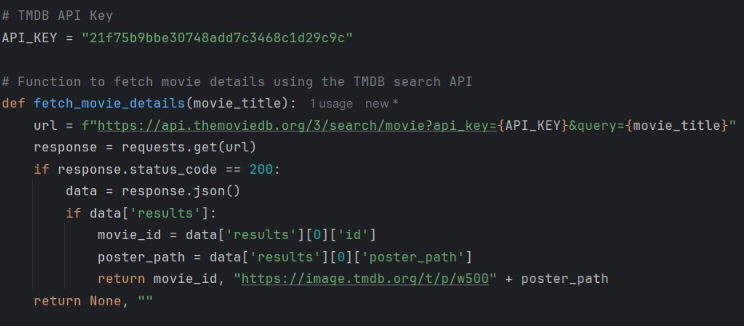
RESULTS
RESULTS Part 3

Slide 10
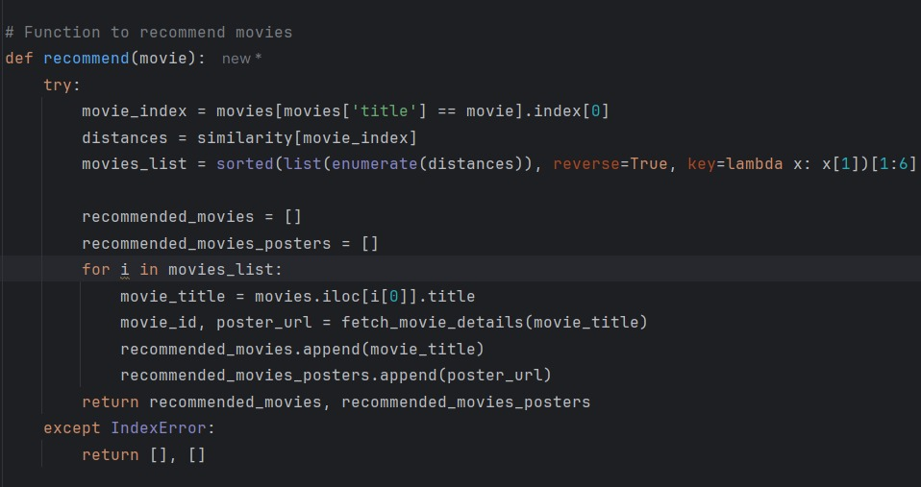
RESULTS Part 3

Slide 11
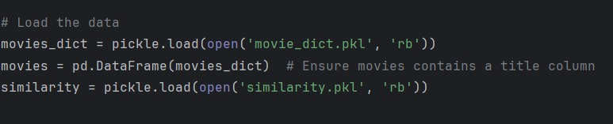
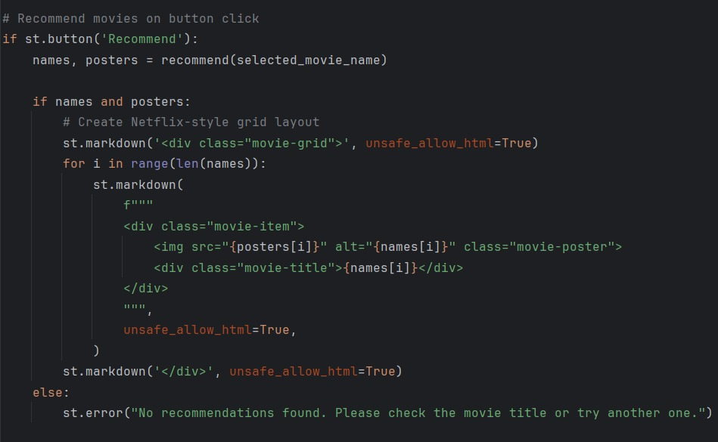
RESULTS Part 3

Slide 12
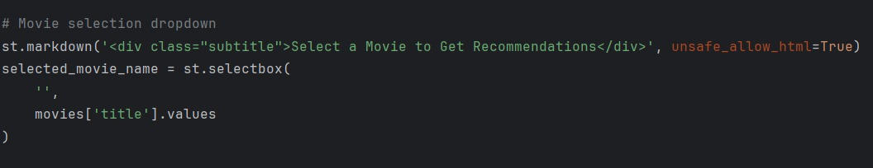
RESULTS Part 3

Slide 13
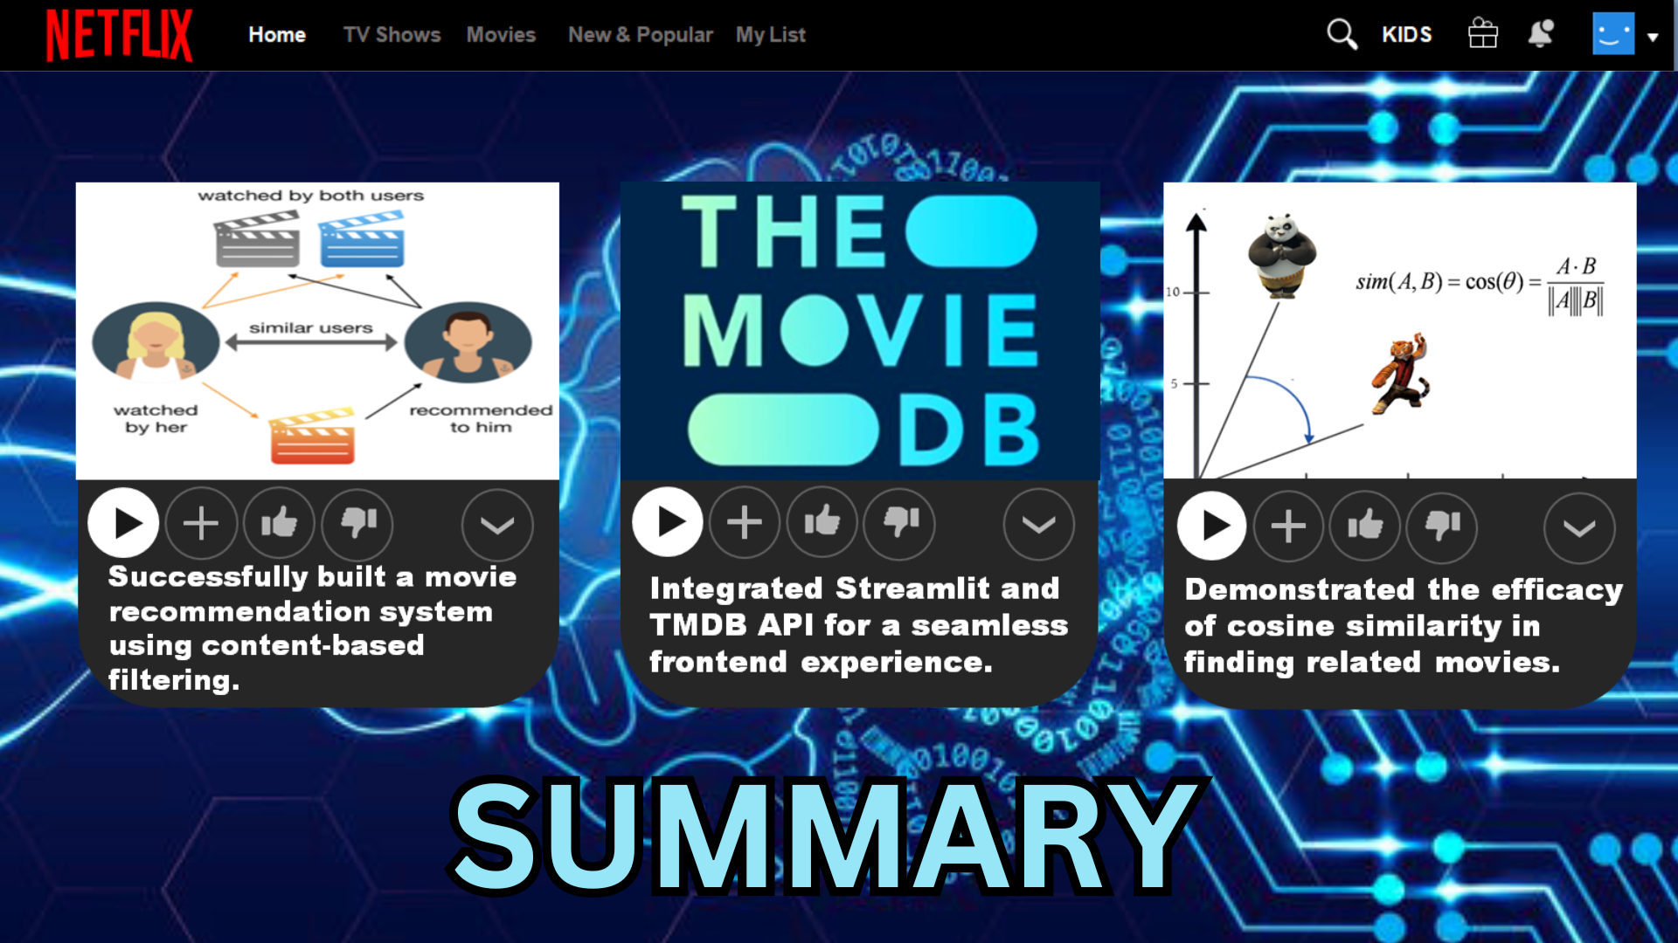
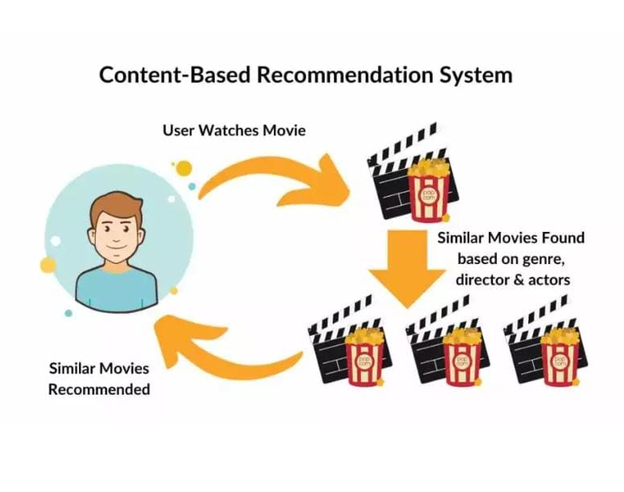

Slide 14
FUTURE WORK
REFERENCeS
1.Incorporate collaborative filtering for hybrid recommendations.
2.Use advanced NLP techniques like Word2Vec or BERT to improve text representation.
3.Add user feedback to further personalize recommendations.
Dataset: TMDB Movie Metadata.
API: TMDB API Documentation.
Tools and Libraries:
Python Libraries: streamlit, requests, pickle, sklearn, nltk, ast.
Text Vectorization: Text Vectorization: Bag of Words.
LINKS:
Recommendation Systems:
https://youtu.be/1xtrIEwY_zY?si=0GDmL_SiUoYK0H0F

Slide 15

Netflix
Home
TV Shows
Movies
New & Popular
My List
KIDS
THANK YOU
FOR LISTENING!
Sign In
100% Done
19+
2 Members
Reporters: Manveen Kaur, Vidhi Goyal
Subject: Machine Learning
Teacher: Dr Sachin Kansal
Sign Out
Questions? Clarifications FAQ About Us Help Center

